Slide 1
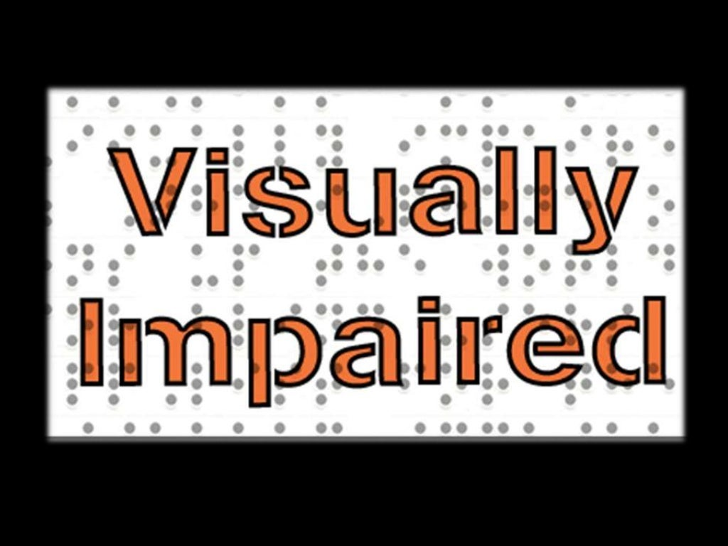

Slide 2
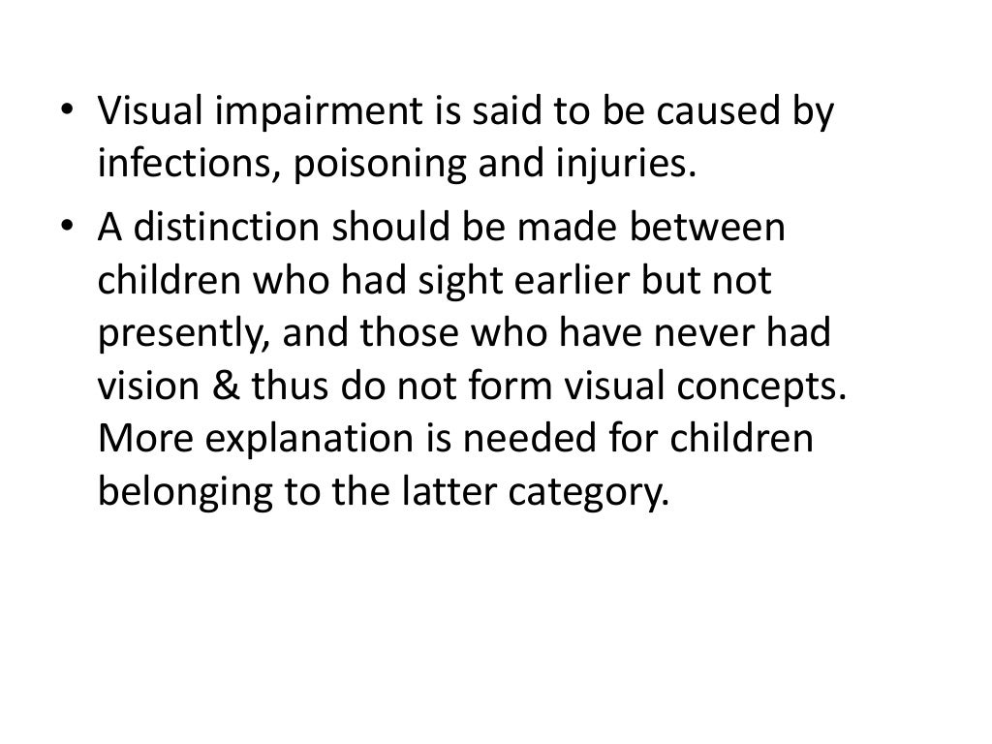

Slide 3
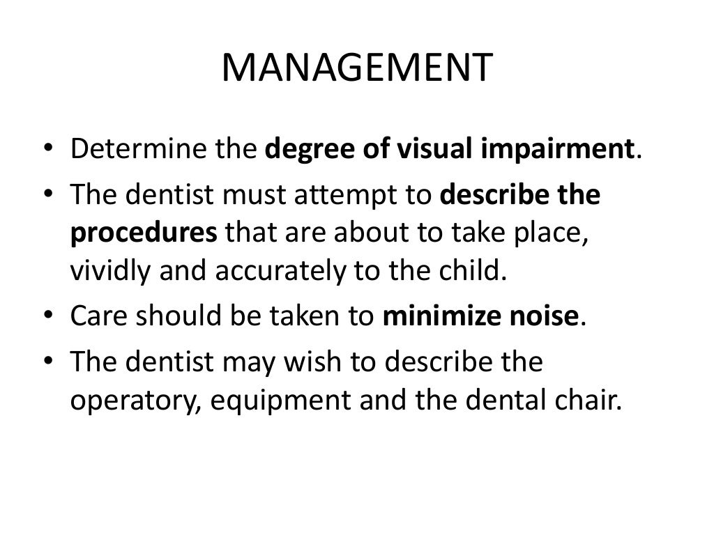

Slide 4
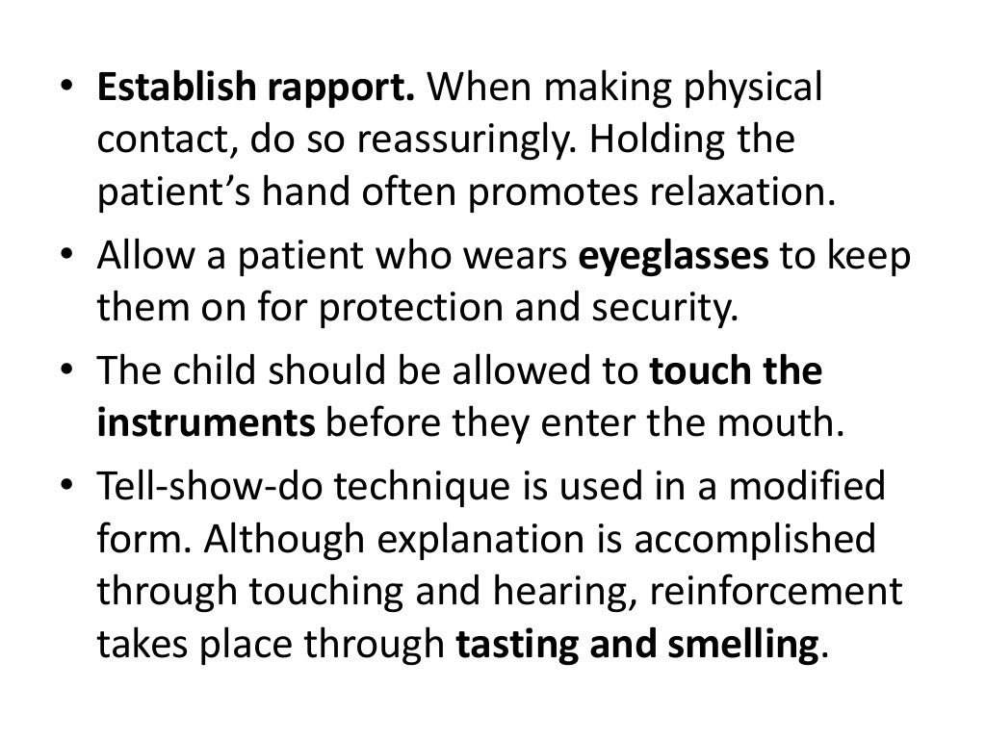

Slide 5
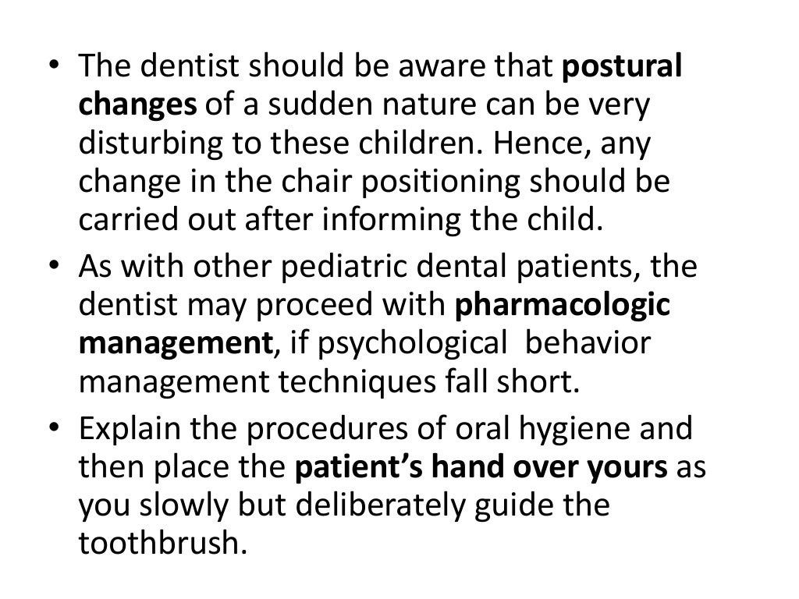

Slide 6
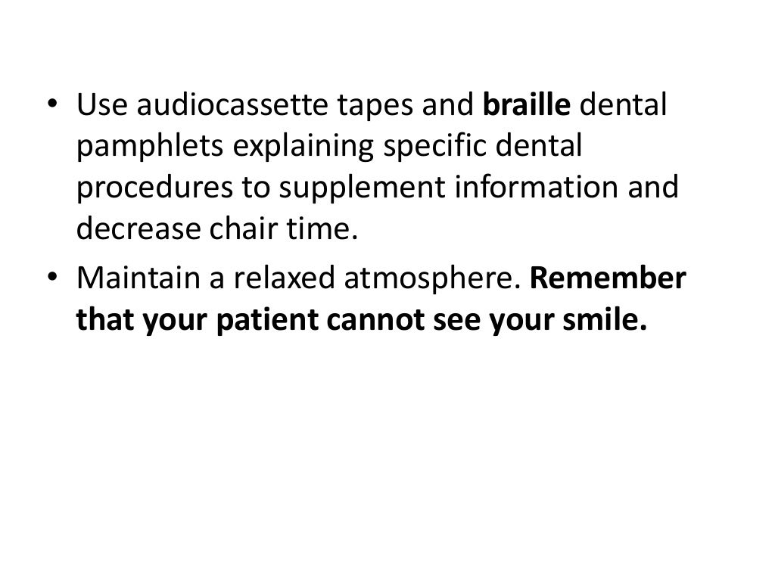

Slide 7


Slide 8
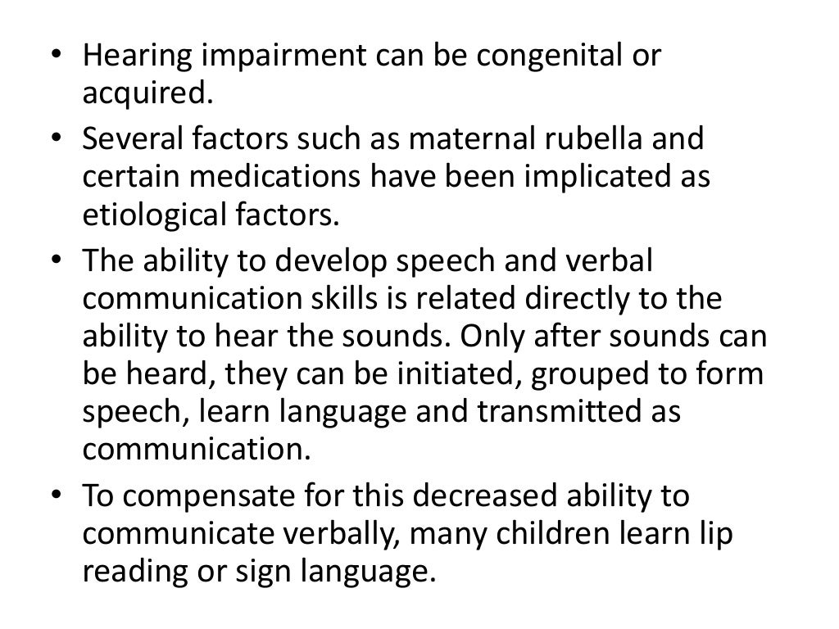

Slide 9
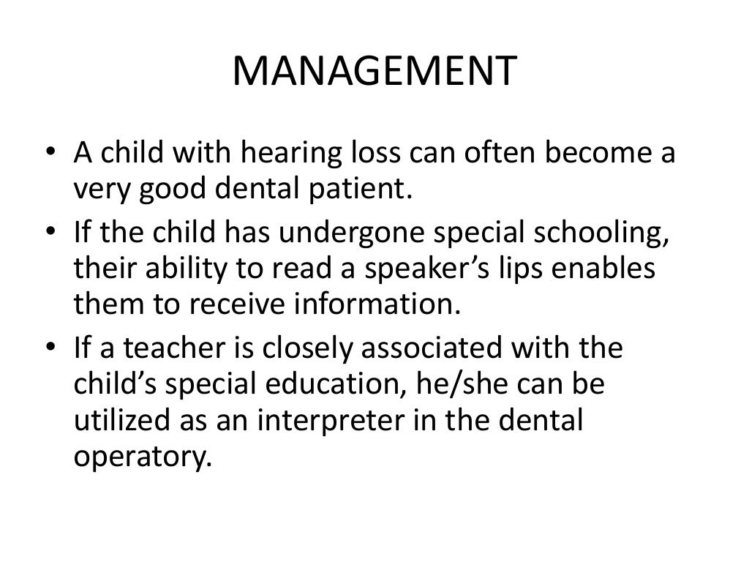

Slide 10
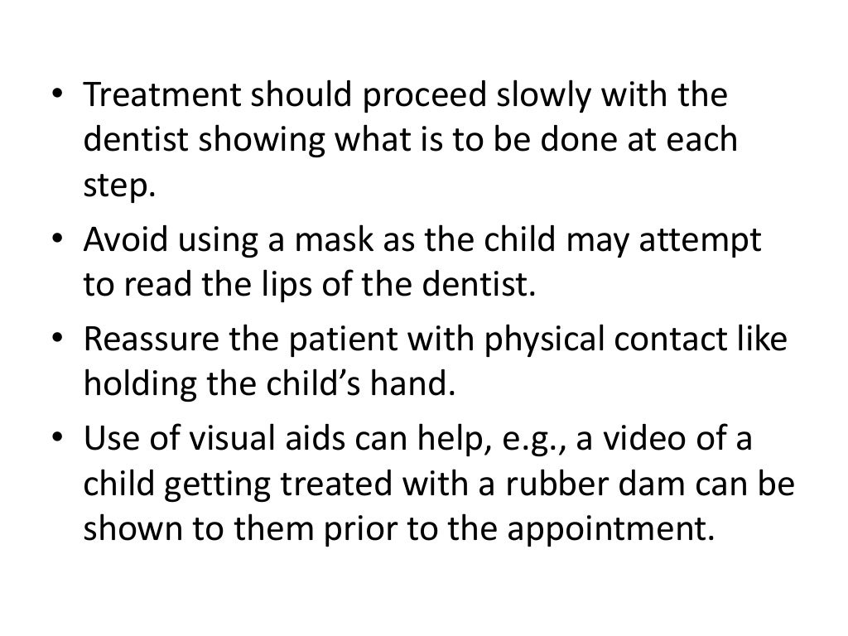

Slide 11


Slide 12
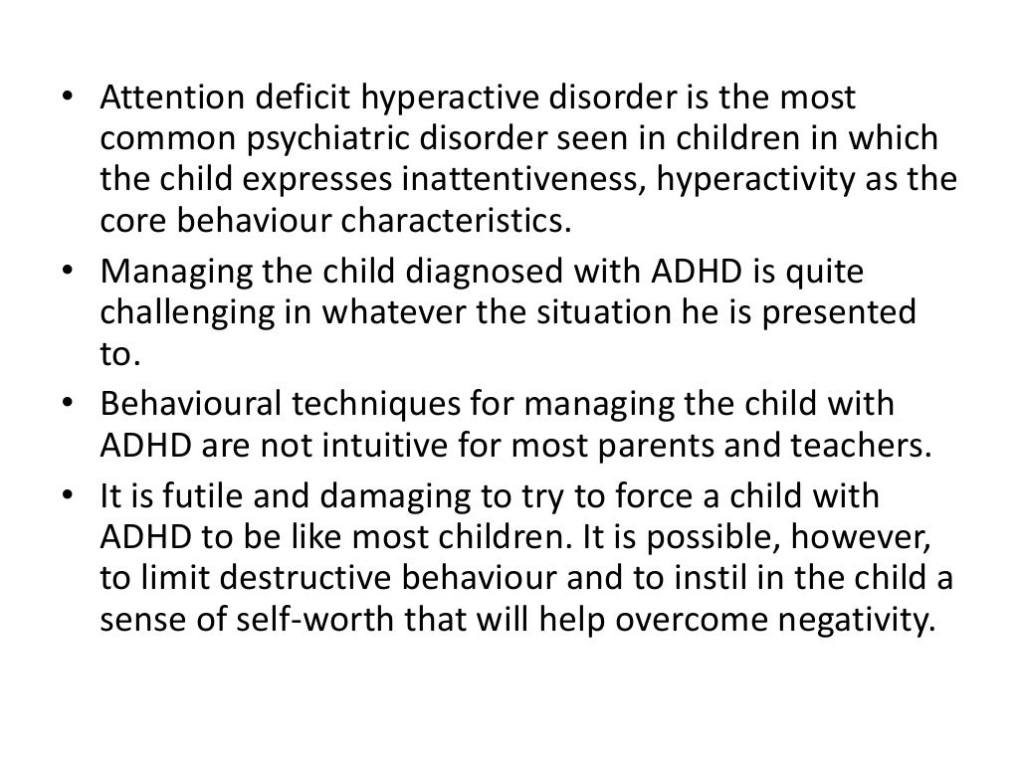

Slide 13
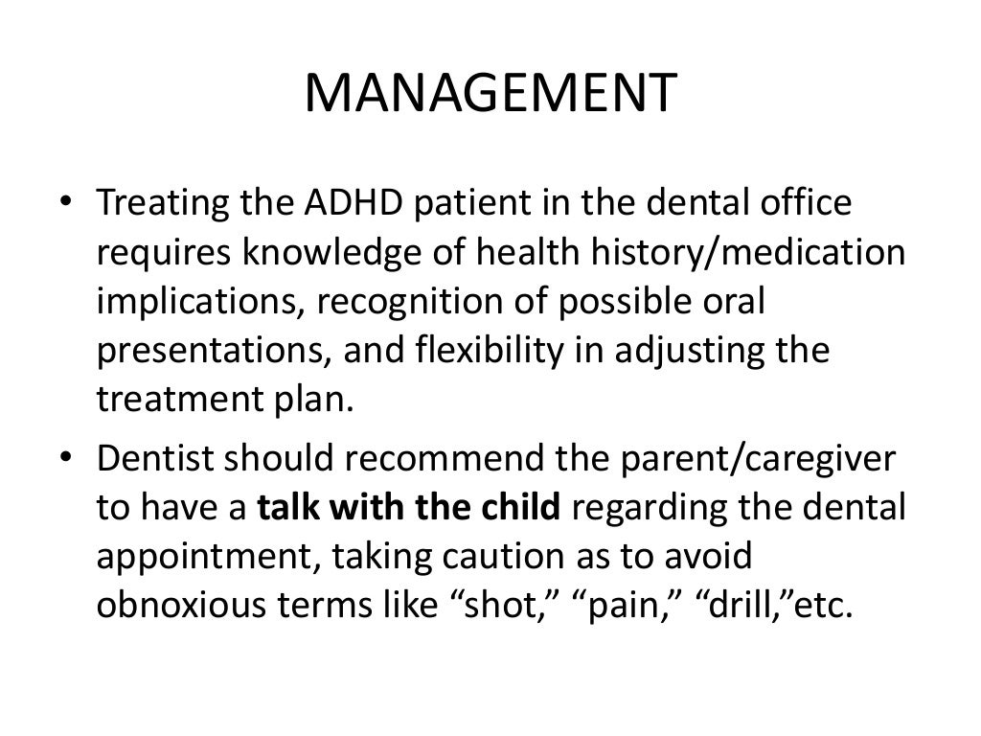

Slide 14
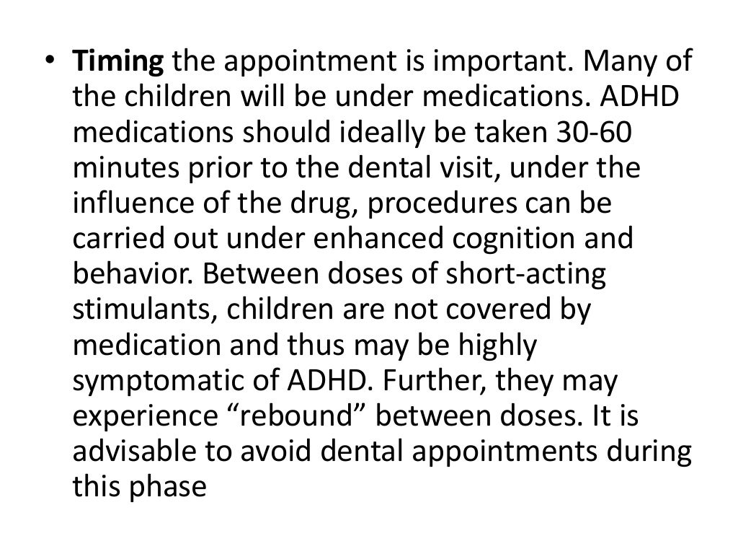

Slide 15
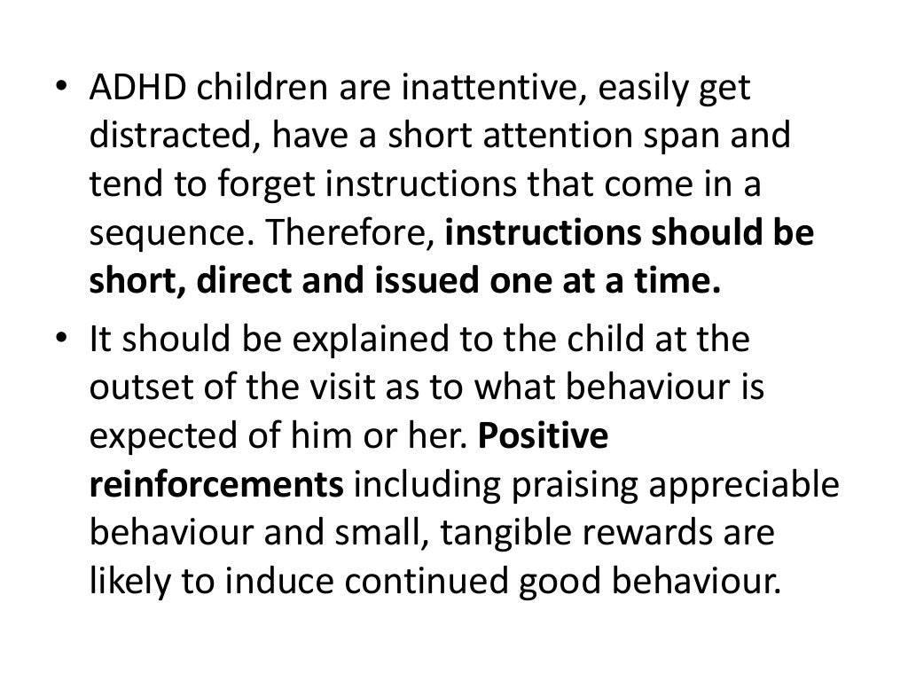

Slide 16
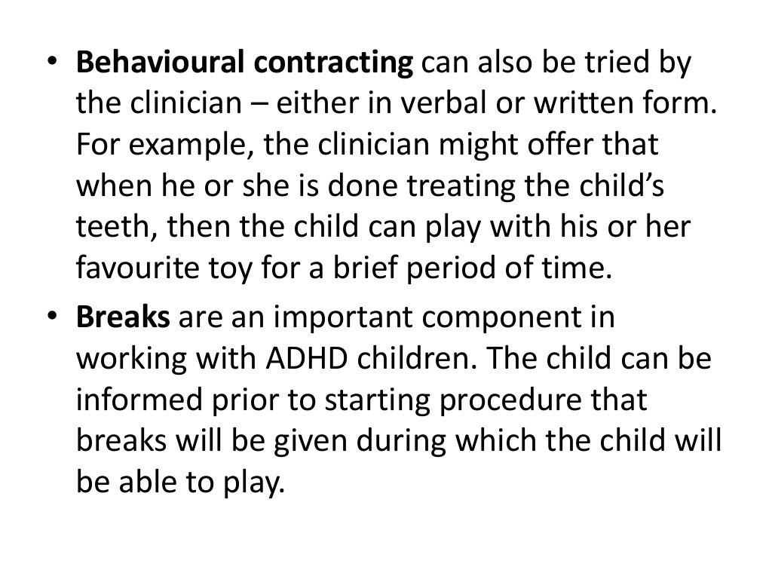

Slide 17
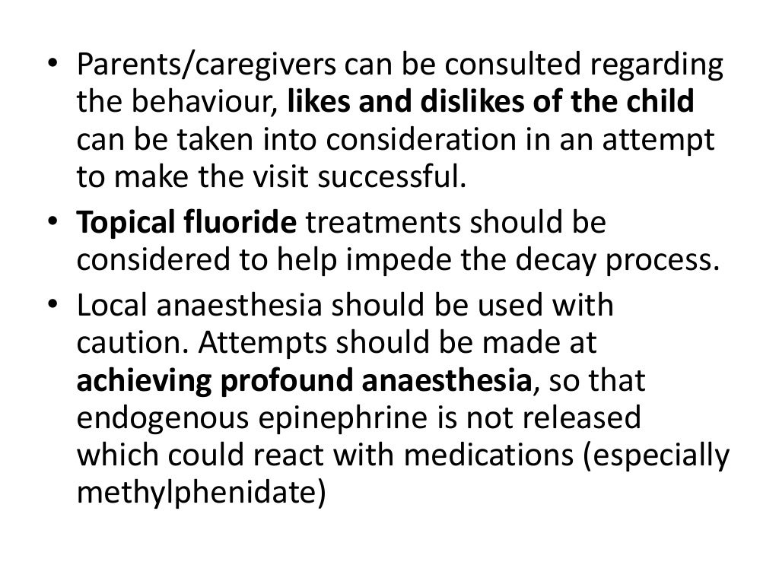

Slide 18
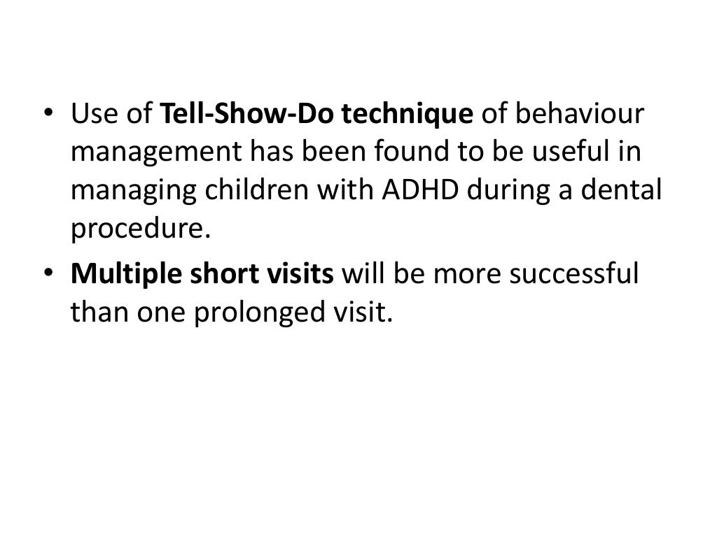

Slide 19
TAKE AWAY HOME MESSAGE
Dental assistant is helpful in obtaining primary information, instructing the patient and advicing the patient of any note worthy or unusual patient.
Mental retardation is defined as an overall IQ lower than 70 associated with functional changes in adaptive behaviour.
Cerebral palsy is a group of disorder of development of movement and posture.

Slide 20
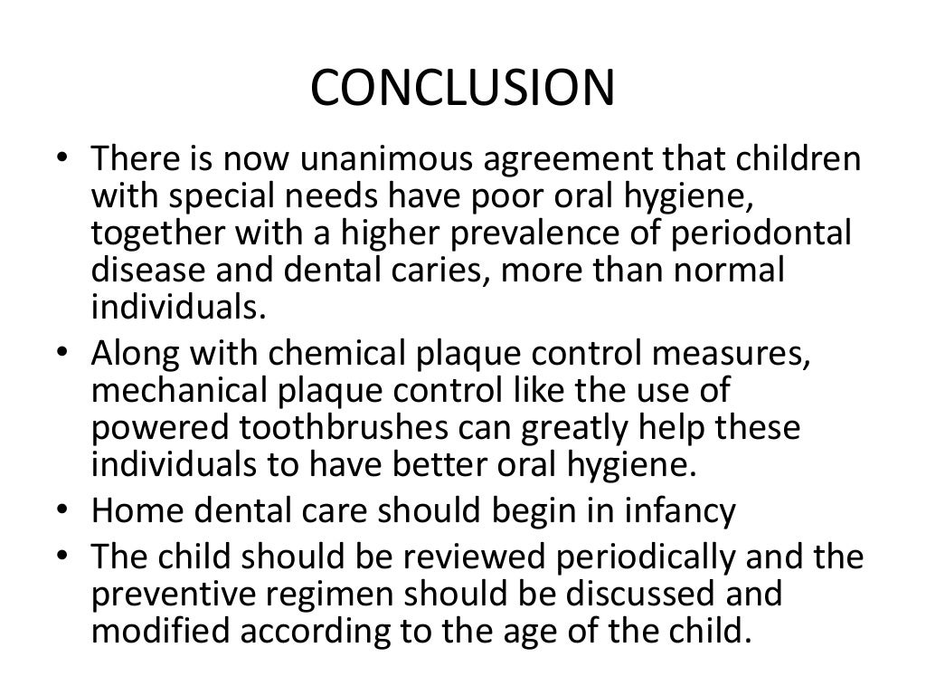

Slide 21


